Slide 1

Maven Market KPI Report
Welcome!
This a report that accompanies the dashboard I made.
It’s a KPI dashboard that covers the performance of Maven Market, a wholesale retail company, over the past 2 years (1997-1998).

Slide 2
Table of Contents:
Comparing the performance against last month: Total Sales, Total Profit, Loss Incurred from Returns, and the count of losses.
Listing the top customer companies in terms of sales, profit, and return rate.
Highlighting the highest regions in North America in terms of sales.
Analyzing the trends of Total Revenue over the two previous years.

Slide 3
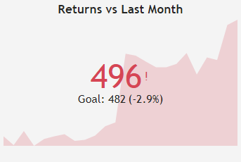
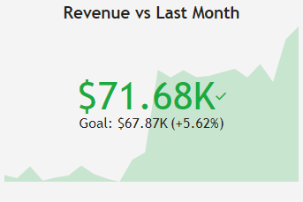
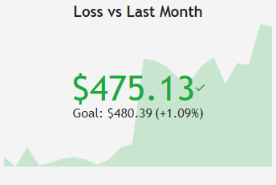
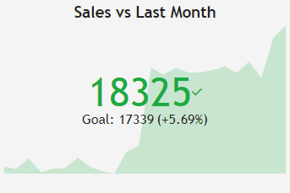
Comparing performance against last month:
Due to the great formatting of these cards, we can quickly notice that we’ve had improvements in most areas. Note that the goal is simply to beat the previous month.
Sales have increased by 5.69% since last month, with revenue close behind with a 5.62% increase.
We do notice a 2.9% increase in returns, which is natural given the increase in sales. However, it’s highly worth noting that despite this, we notice a 1.09% decrease in the losses incurred due to returns.

Slide 4
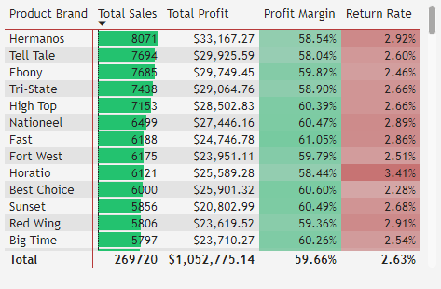
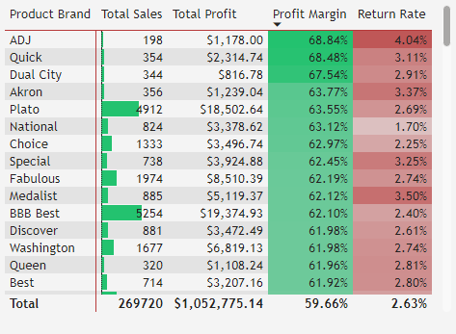
Top customer companies:
We notice that Hermanos, Tell Tale, and Ebony are the three highest companies in terms of sales, and profit. They are not the highest when it comes to profit margin however.
ADJ, Quick, and Dual City boast the highest profit but also suffer from very high return rates, indicating that their goods are of lower quality, thus with a smaller manufacturing price, this led to very low sales.
We can see companies like Plato, BBB Best, Imagine, and others excelling at maintain a high profit margin with relatively low return rates, and lots of sales as well. It’s recommended to focus on these companies.

Slide 5
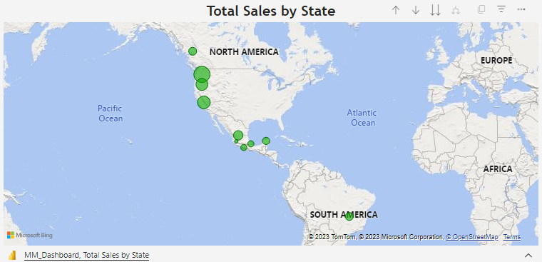
Highlighting the top regions in terms of sale:
To no one’s surprise, a large portion of the orders comes from the US, at 72806 sales, 67% of total sales.
Mexico is second highest, at 72806, or 27%.
Canada has the least sales of the three, at 16091, or 6%.
It is recommended to investment in marketing in Canada, to get the Maven Market name to be more well known there.

Slide 6
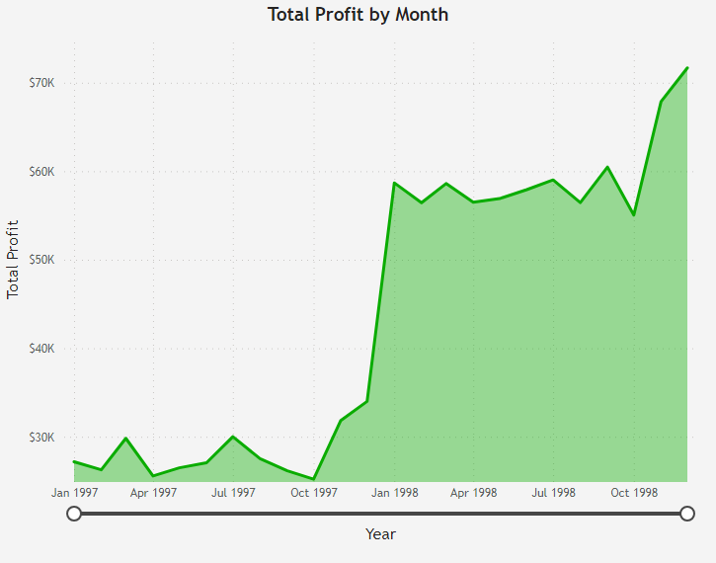
Analyzing the trends of the Total Revenue:
After somewhat mediocre numbers in 1997, around $25K, Maven Market came back very strong starting in 1998.
Starting from Jan 1998, profit has doubled and remained that way for the year, increasing even further in the holiday season into the $70K range
The recommendation is to continue improving the company, in terms of goods, availability, and expansion into new markets.

Slide 7
Conclusion
The company has gained a substantial increase in profit in the start of 1998, reaching well over double the mean of profits in 1997.
In the previous month, we noticed increases in sales, profits, and decreases in losses incurred by returns. But, there has also been an increase in returns, which is to be expected, given the new sale figures.
Companies like ADJ and Quick boast the highest profit margin suffer from high return rates and very low sales, possibly due to low quality and manufacturing costs of their goods. It’s recommended to focus on companies that maintain a high profit margin as well as high sales, like Plato, Imagine, etc.
The number of sales in Canada is less than 1/10 that of sales in the US, which raises the importance of investing in marketing in the Canadian region, to increase Maven Market’s popularity there.
We hope that this report and dashboard has renewed your faith in Maven Market, as well as your excitement to see where we can take it, and how big it can grow. It’s been a stellar year for us, and we’re confident that we can surpass it time and time again. Thank you for your attention!

